Slide 1
E - Nursery
Group Number: 6
Saharsh Gupta (17-BCA-072)
Purvi Golchha (17-BCA-097)
Murtaza Lokhandwala (17-BCA-118)

Slide 2
Internal Guide: Mrs. Nithya Nadar External Guide: Mr. Paras Dharsanda

Slide 3
Index
About Company
Company Details
About Project
Existing System
Requirement Gathering
Proposed System
Tools And Technologies Required
DFD(Data Flow Diagram)
Data Dictionary

Slide 4
About Project
The Web application lets you search different plants.
The Customer can buy a variety of plants and tools according to requirements.
The Customer can hire a gardener.

Slide 5
Existing System
There is No Website available for the Nursery Company.
The Customer needs to visit the Nearest Nursery for getting plants and tools required.
Customer cannot find a variety of plants with the Nursery.

Slide 6
Requirement Gathering
It is a Web Application which should have User friendly interface.
There should be accurate information of Plants available here.
User should be easily searching plants and gardening tools through many filters faster.
Providing easy purchasing facility and generating Invoice.
Gardener should be hired Online.

Slide 7
Proposed System
There are three Entities:
Admin
Customer
Visitor

Slide 8
Admin
Admin can Login to Website.
Admin can Add, Delete, Update Listings/Product/Information.
Admin can View and Manage Placed Order.
Admin will Manage Payment.
Admin manages Gardeners Profile by Adding, Updating, Deleting manually on behalf of Gardener.
Admin manages Order of Gardener on Request.
Admin updates Gardener about the Work by manually contacting.

Slide 9
Customer
Customer can login.
Customer can view and search products through filters.
Customer should be able to purchase Nursery products online.
Can Hire Gardener on Request.
Can view Gardener Photo, Gardener Profile, Gardener Address.
Payment Gateway.
Customer can view Past Orders.
Customer can give ratings to Gardner.
Bill invoice will be sent through email as well as with product.

Slide 10
Visitor
Visitor can view plants and tools.
Plant’s Information will be shown
Visitor can request gardener details.
Visitor can request for viewing the ratings.

Slide 11




Tools & Technologies Required
Front End : PHP 7.1
Back End : My SQL 5.6
Presentation Tool : Microsoft PowerPoint 2016
Designing Tool : Microsoft Office Visio 2016
Other Tools : Microsoft Office 2016

Slide 12
DFD(Data Flow Diagram)
Context Level

Slide 13
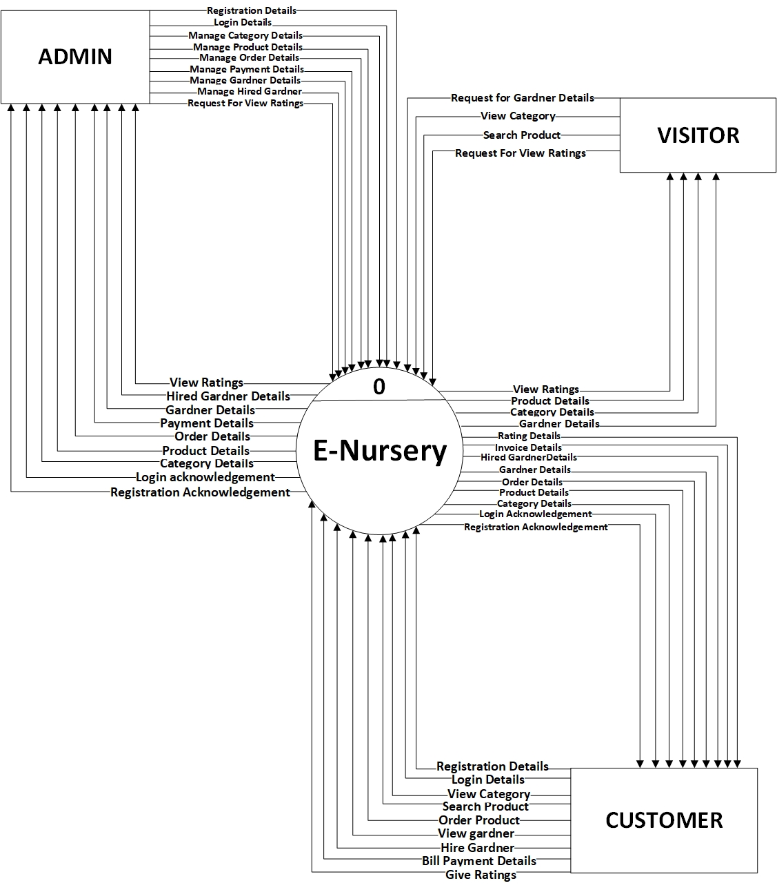

Slide 14
Level 1

Slide 15
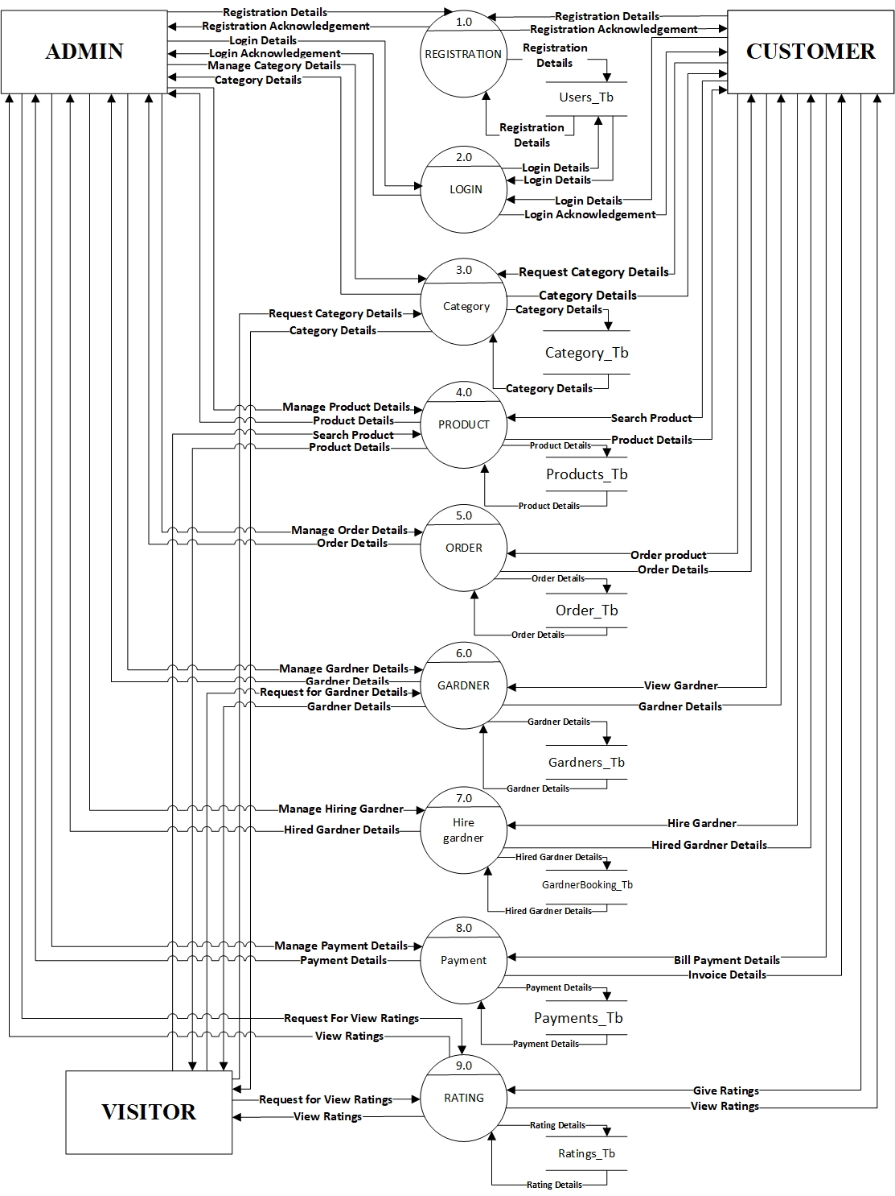

Slide 16
Level 2(2.0 Login)

Slide 17
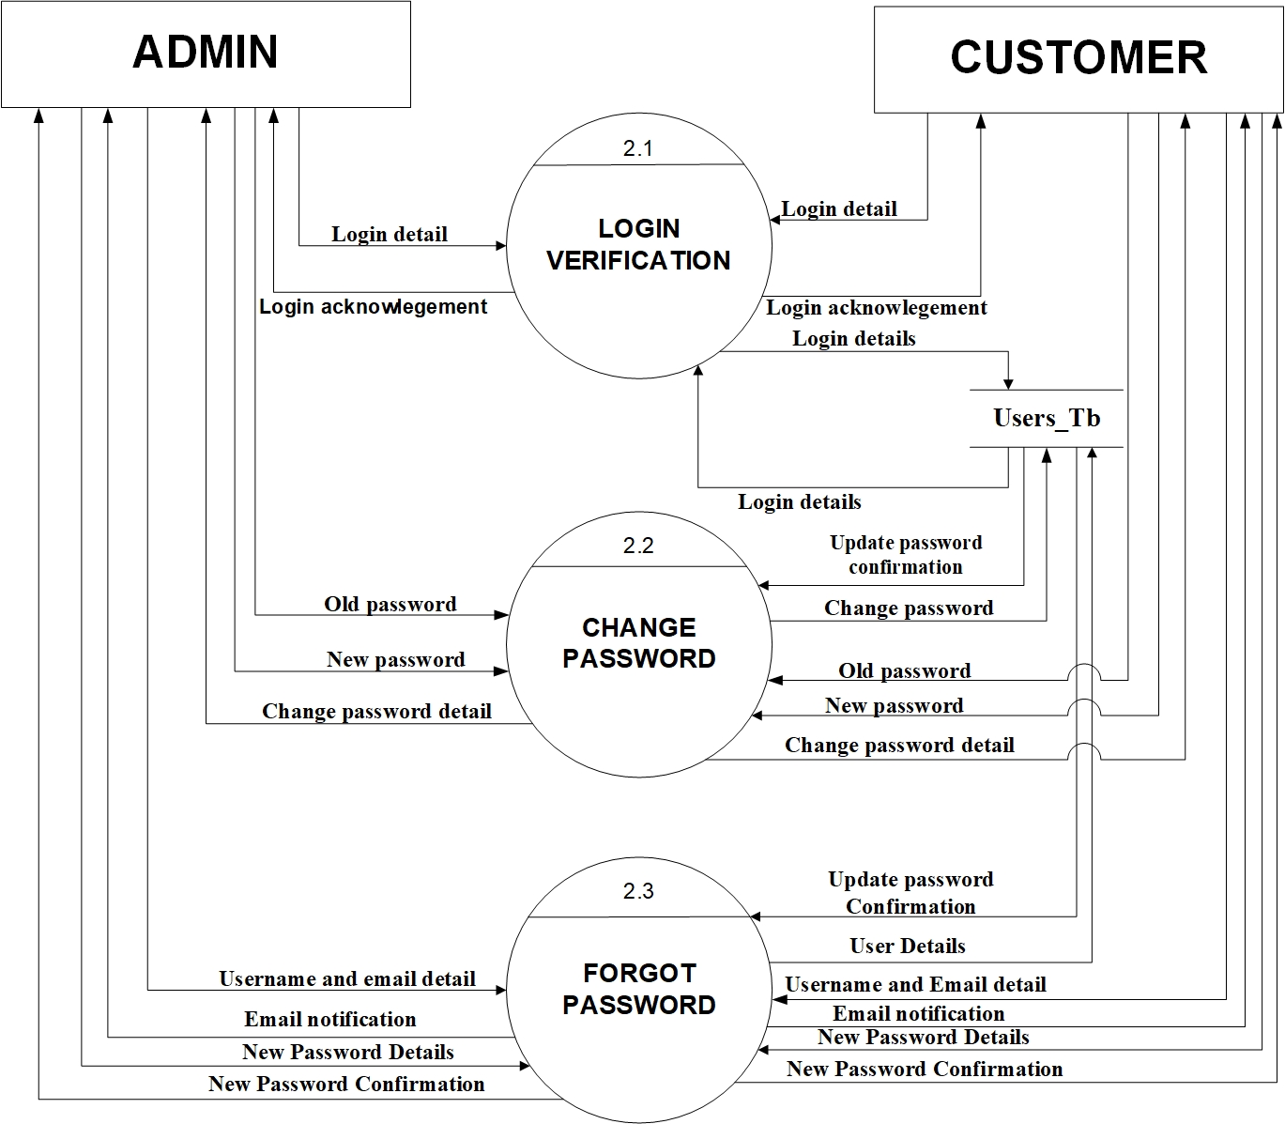

Slide 18
Level 2(3.0 Category)

Slide 19
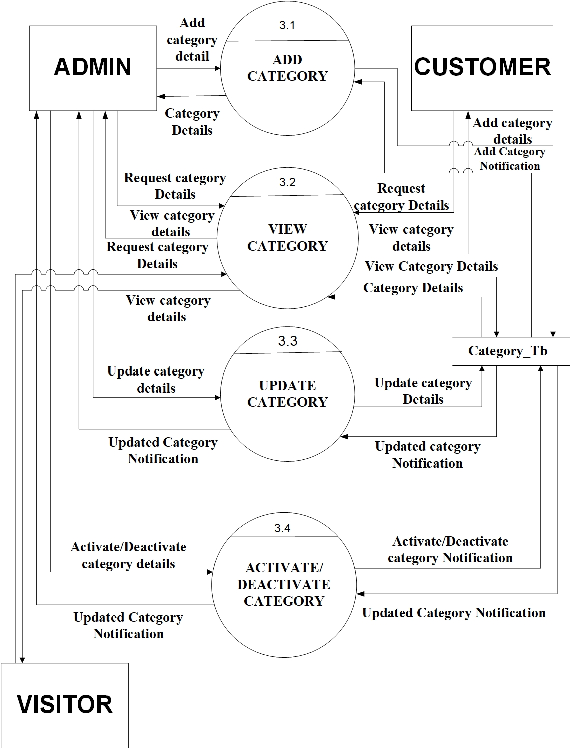

Slide 20
Level 2(4.0 Product)

Slide 21
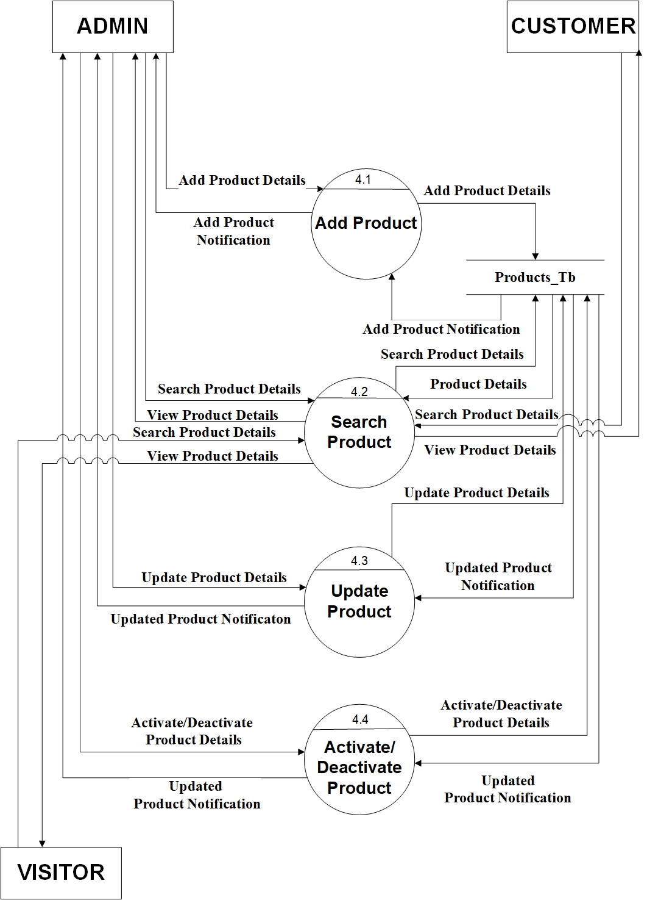

Slide 22
Level 2(5.0 Order)

Slide 23
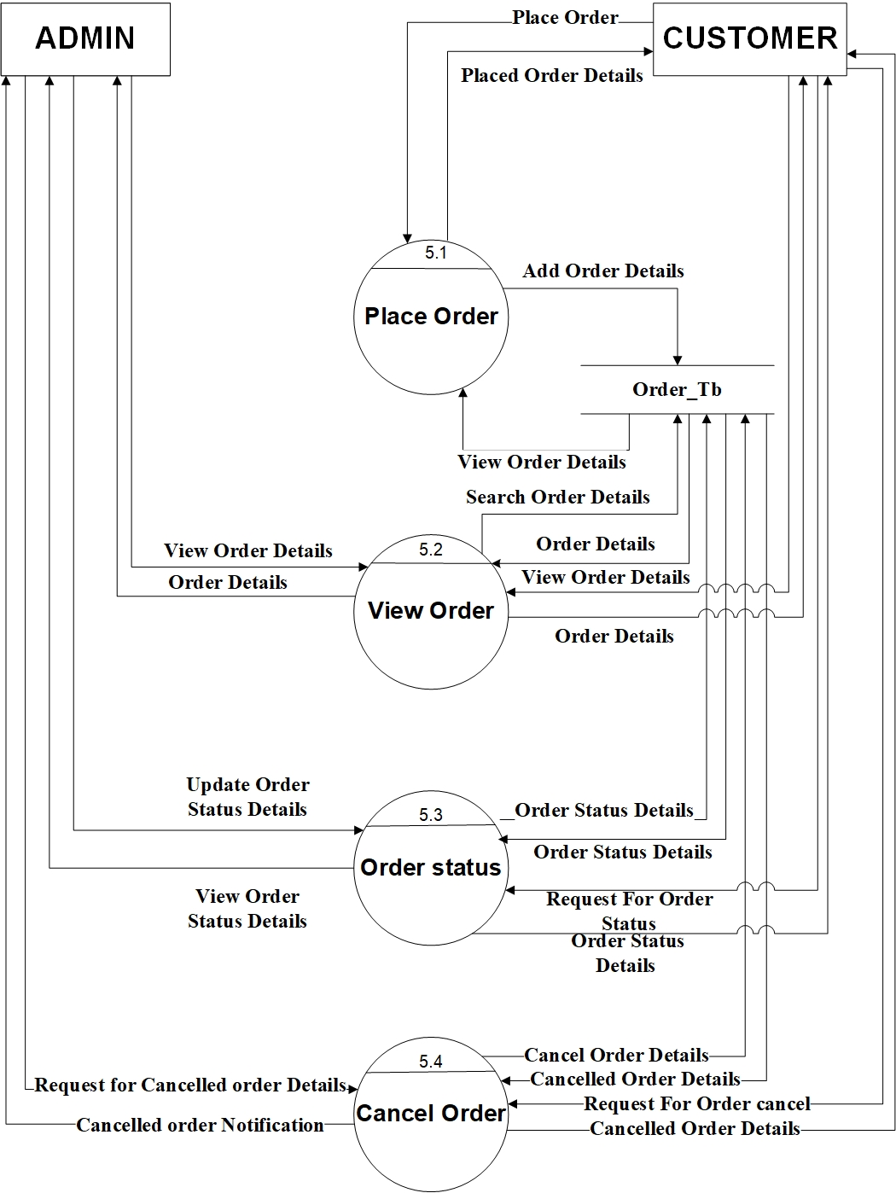

Slide 24
Level 2(6.0 Gardner)

Slide 25
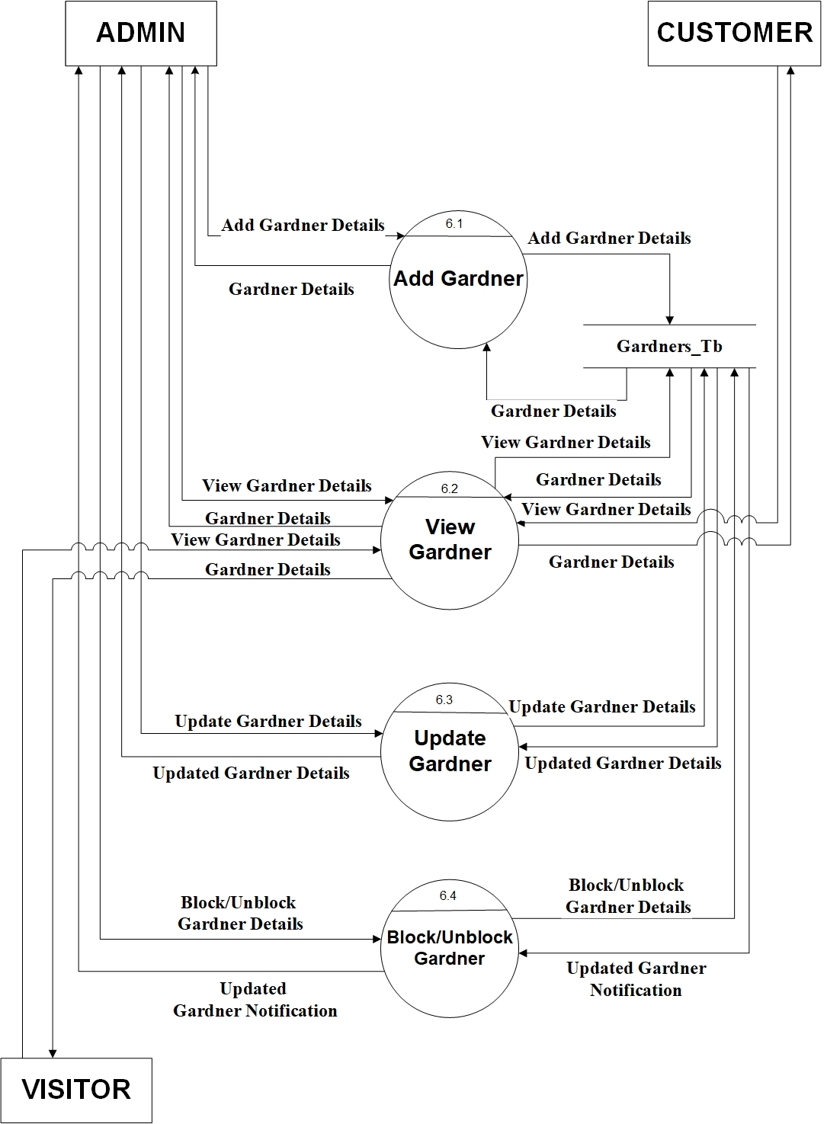

Slide 26
Level 2(7.0 Hire Gardner)

Slide 27
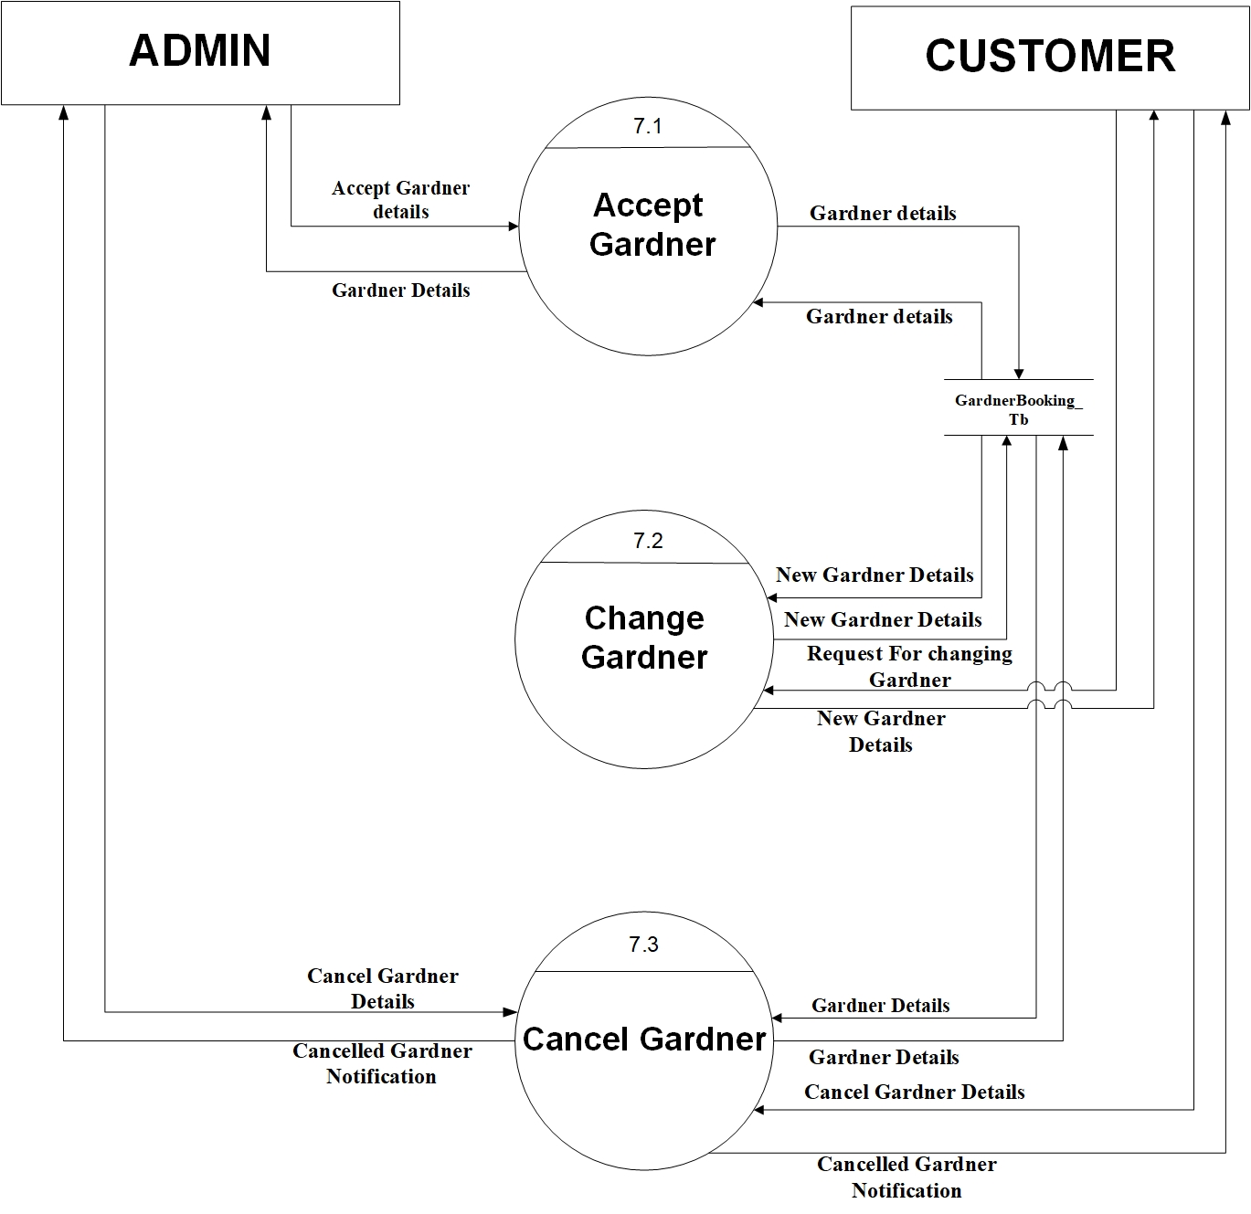

Slide 28
Level 2(8.0 Payment)

Slide 29
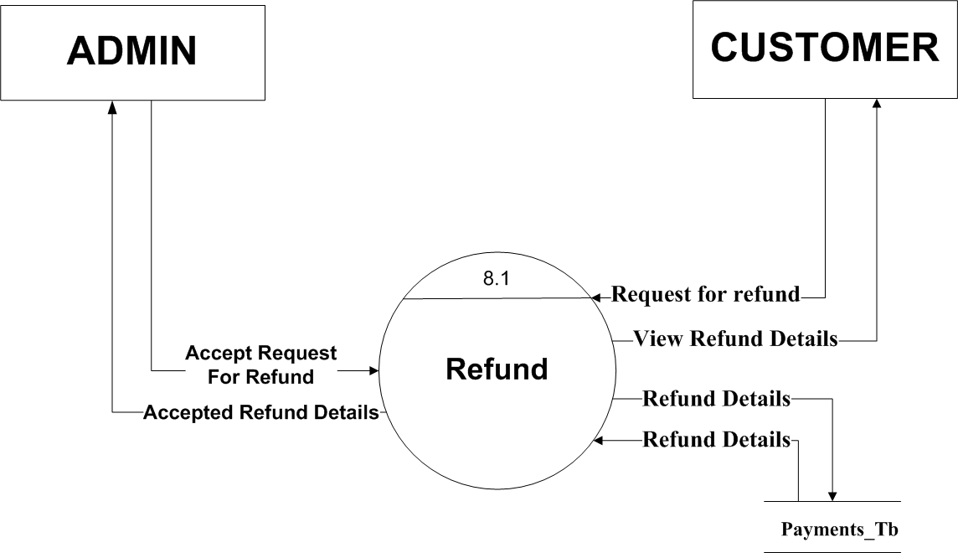

Slide 30
ERD

Slide 31
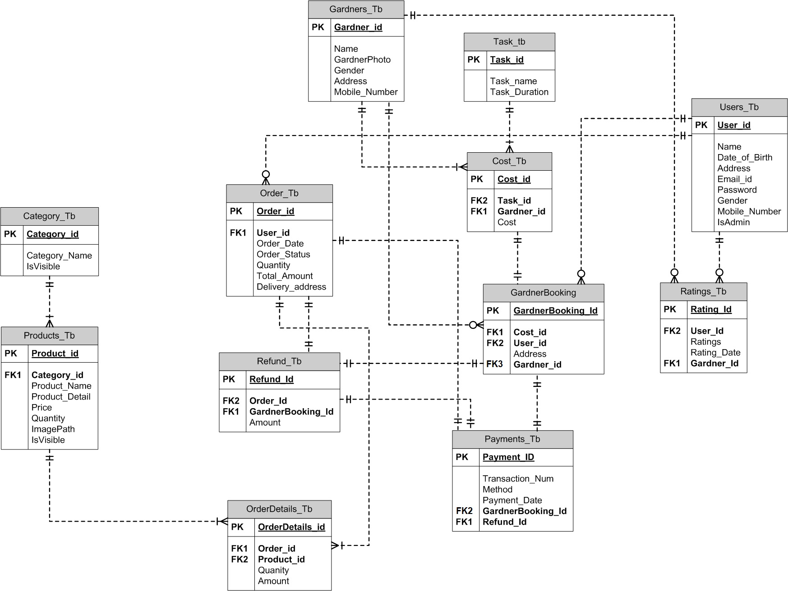

Slide 32
Data Dictionary

Slide 33
Table Name : Users_Tb Description : All the details of Users
Field Name | Data Type | Size | Constraint | Description
User_Id | Integer | 6 | Primary key | It will store the id of User
Name | Varchar | 20 | Not Null | It will store the name of User
Date_of_Birth | Date |  | Not Null | It will store the date of birth of User
Address | Varchar | 160 | Not Null | It will store the address of User
Email_Id | Varchar | 25 | Not Null, Unique | It will store the email id of User
Password | Varchar | 15 | Not null | It will store the password of User
Gender | Bit |  | Not Null | It will store the gender of User. 0 is Male and 1 is Female
Mobile_Number | Integer | 10 | Not Null, Unique | It will store the User’s Mobile Number
IsAdmin | Boolean |  | Not Null | It will store if User is admin or Customer. True is Admin and False is Customer

Slide 34
Table Name : Category_Tb Description : It will store All the details of Categories.
Fieldname | DataType | Size | Constraint | Description
Category_Id | Integer | 6 | Primary key | It will store the unique id of Category.
Category_Name | Varchar | 30 | Unique | It will store the Category name.
IsVisible | Boolean |  | Not Null | It will store where Category is Visible or not.

Slide 35
Table Name : Products_Tb Description : It will store all details of Products
Field Name | DataType | Size | Constraint | Description
Product_Id | Integer | 6 | Primary key | It will store the Id of Product.
Product_Name | Varchar | 30 | Unique ,Not Null | It will store the name of Product.
Product_Detail | Text |  | Not null | It will store the description of Product.
Price | Decimal | (4,2) | Not Null | It will store price of the Product.
Quantity | Integer | 3 | Not Null | It will store the quantity of the Product.
ImagePath | Varchar | 50 | Not Null | It will store the path of image file.
IsVisible | Boolean |  | Not Null | It will store where Product is Visible or not.
Category_id | Integer | 6 | Foreign Key | This constraint joins Products Table and Category Table.

Slide 36
Table Name : Order_Tb Description : It will store all the Orders.
Field Name | DataType | Size | Constraint | Description
Order_Id | Integer | 6 | Primary key | It will store the unique id of Order.
User_Id | Integer | 6 | Foreign Key | This constraint joins Order Table and User Table.
Order_Date | Date |  | Not Null | This will store the Date when Order Placed.
Order_Status | Varchar | 15 | Not Null | It will store the status of the Order. i.e. Pending or Delivered.
Quantity | Integer | 2 | Not Null | It will store the total number of products ordered.
Total_Amount | Decimal | (5,2) | Not Null | It will store the total amount of the order.
Delivery_address | Varchar | 160 | Not Null | It will store the address for delivery.

Slide 37
Table Name : OrderDetails_Tb Description : It will store all the Orders in Detailed.
Field Name | DataType | Size | Constraint | Description
OrderDetails_Id | Integer | 6 | Primary key | It will store the unique id of Order Details.
Order_Id | Integer | 6 | Foreign key | This constraint joins Order Details Table and Order Table.
Product_Id | Integer | 6 | Foreign key | This constraint joins Order Details Table and Products Table.
Quantity | Integer | 2 | Not Null | It will store the quantity of products ordered.
Amount | Decimal | (5,2) | Not Null | It will store the amount of the order.

Slide 38
Table Name : Gardners_Tb Description : All the details of Gardner.
Field Name | Data Type | Size | Constraint | Description
Gardner_Id | Integer | 6 | Primary key | It will store the id of Gardner.
Name | Varchar | 20 | Not Null | It will store the name of Gardner.
GardnerPhoto | Varchar | 50 | Not Null | It will store the path of Profile Photo file.
Gender | Bit |  | Not Null | It will store the gender of Gardner. 0 is Male and 1 is Female
Address | Varchar | 160 | Not Null | It will store the address of Gardner
Mobile_Number | Integer | 10 | Not Null, Unique | It will store the Gardner’s Mobile Number

Slide 39
Table Name: Task_Tb Description : All the details of Task by Gardner.
Field Name | Data Type | Size | Constraint | Description
Task_Id | Integer | 3 | Primary key | It will store the id of Task.
Task_name | Varchar | 30 | Not Null | It will store the name of task.
Task_Duration | Varchar | 30 | Not Null | It will store the Duration of task.

Slide 40
Table Name: Cost_Tb Description : All the details of Cost of Gardner Task.
Field Name | Data Type | Size | Constraint | Description
Cost_Id | Integer | 3 | Primary key | It will store the id of Cost.
Cost | Decimal | (5,2) | Not Null | It will store the cost of the particular task.
Task_Id | Integer | 3 | Foreign key | This constraint joins Cost Table and Task Table.
Gardner_Id | Integer | 6 | Foreign Key | This constraint joins Cost Table and Gardner Table.

Slide 41
Table Name : GardnerBooking_Tb Description : All the details of Hired Gardner.
Field Name | Data Type | Size | Constraint | Description
GardnerBooking_Id | Integer | 6 | Primary key | It will store the id of Gardner Booking.
Gardner_Id | Integer | 6 | Foreign Key | This constraint joins Gardner Booking Table and Gardner Table.
Address | Varchar | 160 | Not Null | It will store the address of Work.
User_Id | Integer | 6 | Foreign Key | This constraint joins Gardner Booking Table and User Table.
Cost_Id | Integer | 3 | Foreign key | This constraint joins Gardner Booking Table and Cost Table.

Slide 42
Table Name : Payments_Tb Description : It will store all details of Payments
Fieldname | DataType | Size | Constraint | Description
Payment_ID | Varchar | 4 | Primary key | It will store the ID of Payment.
Order_Id | Integer | 6 | Foreign key | This constraint joins Payments Table and Order Table.
GardnerBooking_Id | Integer | 6 | Foreign key | This constraint joins Payments Table and Gardner Booking Table.
Transaction_Num | Varchar | 12 | Not Null | It will store the Transaction Number.
Method | Varchar | 10 | Not null | It will store the method of payment.
Payment_date | Date |  | Not null | It will store the date of payment.
Payment_Status | Varchar | 15 | Not Null | It will store the Payment Status. i.e. Paid or Pending.
Refund_Id | Integer | 6 | Foreign Key | This constraint joins Payments Table and Refund Table.

Slide 43
Table Name : Refund_Tb Description : All the details of Cancelled order.
Field Name | Data Type | Size | Constraint | Description
Refund_Id | Integer | 6 | Primary key | It will store the id of refund order.
Order_Id | Integer | 6 | Foreign key | This constraint joins Refund Table and Order Table.
GardnerBooking_Id | Integer | 6 | Foreign key | This constraint joins Refund Table and Gardner Booking Table.
User_Id | Integer | 6 | Foreign Key | This constraint joins Refund Table and User Table.
Amount | Decimal | (5,2) | Not null | It will store the amount of Order.

Slide 44
Table Name : Ratings_Tb Description : It will store details of Rating.
Field Name | DataType | Size | Constraint | Description
Rating_Id | Integer | 6 | Primary key | It will store the unique id of Rating.
User_Id | Integer | 6 | Foreign Key | This constraint joins Order Table and User Table.
Ratings | Integer | 2 | Not Null | It will store Rating out of 10.
Rating_Date | Date |  | Not Null | It will store the date of Rating.
Gardner_Id | Integer | 6 | Foreign Key | This constraint joins Ratings Table and Gardner Table.

Slide 45
Thank You.

